Slide 1
Cost of Higher Education in Illinois
Project 2 Data Science Bootcamp
Group 2

Slide 2
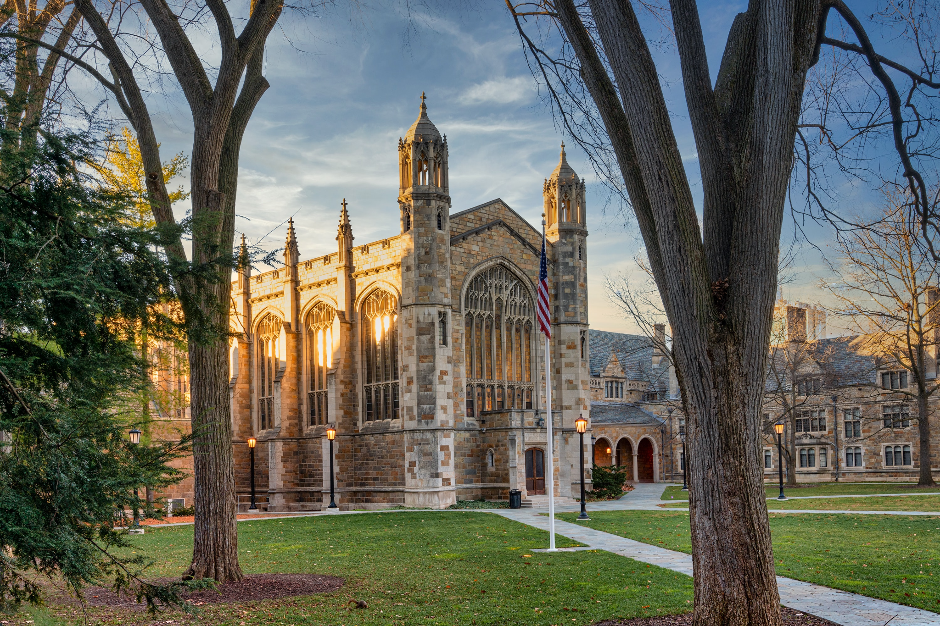
Agenda
Project Overview
Getting the data
Demo
What did we Learn?

Slide 3
Project Overview

Slide 4
Project Overview
Team: Matt Godfrey, Anne Good, Mariano Rivera, Grace Zafar
Topic: Higher Education Costs
Why: We all found the topic interesting and the dataset was pretty clean
and easy to use
Github Repo: https://github.com/sweeneygood/cost-of-higher-ed
Proposal: link here

Slide 5
Project Overview - Planning
Task | Main Contact Person
Load Data using Jupyter Notebook, DB Setup, Flask Server | Anne
HTML/CSS/Bootstrap | Grace
Leaflet Map, Markers, OnClick Marker | Matt
First Visualization with passing data - Bar Graph | Mariano
Visualization - Pie Graph - Chart.js | Group

Slide 6
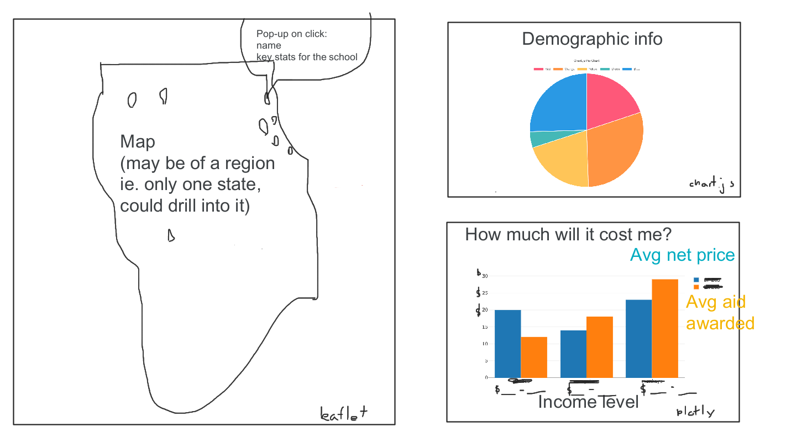

Slide 7
Getting the Data

Slide 8
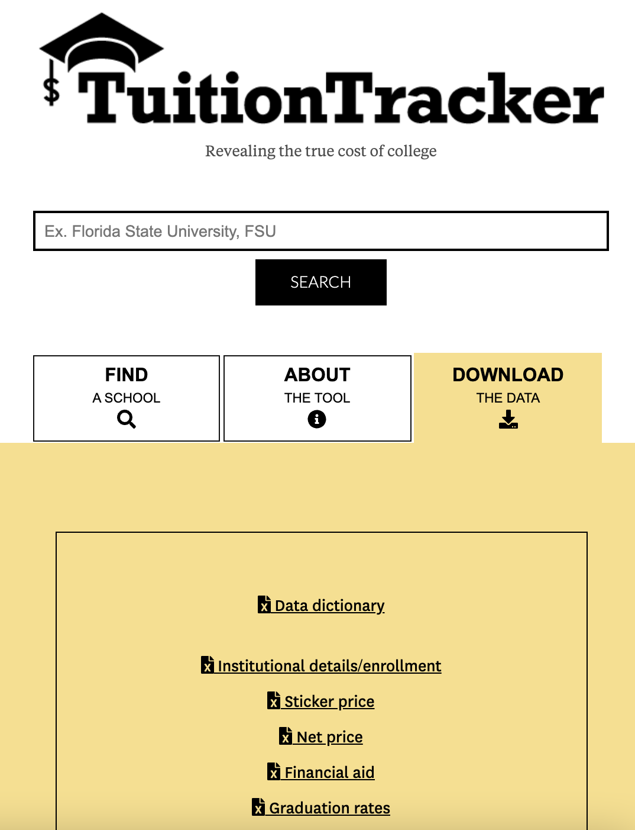

https://www.tuitiontracker.org/
IPEDS
https://nces.ed.gov/ipeds/

Slide 9
Jupyter
Notebook
app.py
(Flask Server)
index.html
CSVs
PostgreSQL
logic.js
app.js
Parts of the application
plots.js

Slide 10
Demo

Slide 11
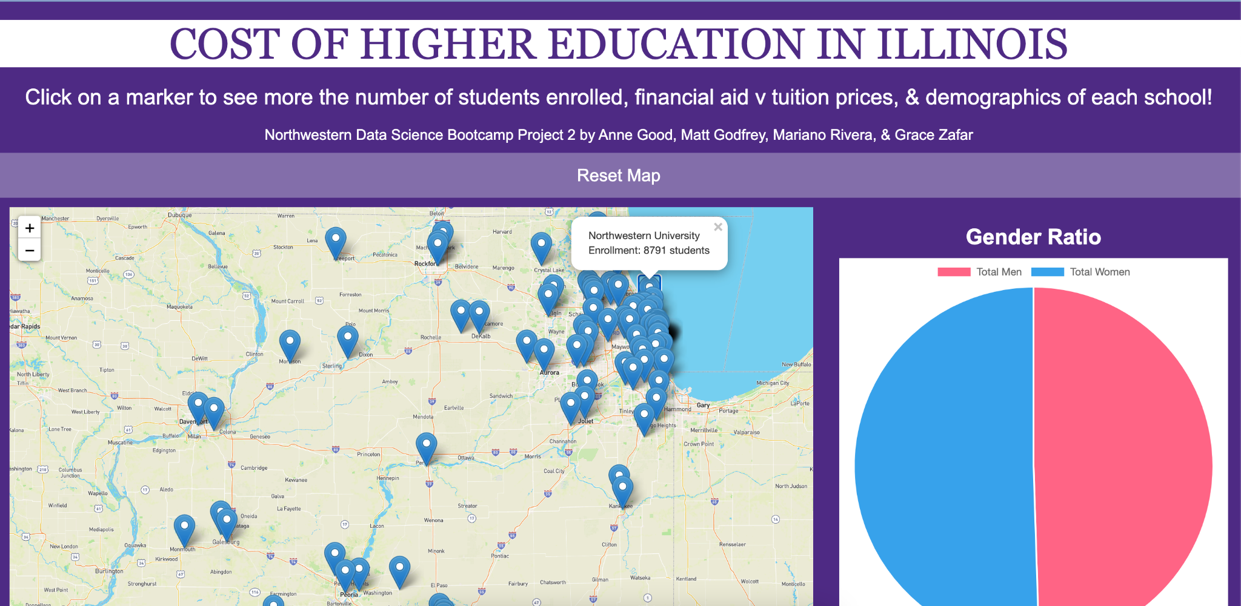
Cost of Higher Ed Demo
http://127.0.0.1:5000/

Slide 12
Learnings

Slide 13

What did we Learn?
What would we improve?
What data to include?
Markers/binding data
Flask and PostgreSQL
Github/Git
Chart.js
Finalizing

